Slide 1
Process Control

Slide 2
What is a Process?
A process can be idea of as an instance of a program in execution.
We called this an ‘instance of a program’,
Because if the same program is run 10 times then there will be 10 corresponding processes.
Process control is a discipline that deals with architectures, mechanisms and algorithms for maintaining the output of a specific process within a desired range.

Slide 3
Process Control is the active changing of the process based on the results of process monitoring.
Activities involved in ensuring a process is expected, constant, and again and again operating at the target level of performance with only normal variation.
A process control system monitors the manufacturing environment and electronically
controls the process.

Slide 4
Process Identifiers
Each process has its own unique process ID which it is identified in the system.
Besides it own ID, a parent’s process ID is also associated with a process.
The process control provided by UNIX. Process includes the creation of new processes, executing programs, and process termination.

Slide 5
Process Identifiers
Process IDs are the process identifiers that are non negative numbers associated with a process.
These numbers are unique across the processes running in the system.
This uniqueness of the process ID sometimes is used by the process to create some unique filenames.

Slide 6
When a process is terminated from system, its process ID is made available for reuse.
specific delay that is accounted before making the process ID available for reuse.
So a delay is added before reusing the same process ID.

Slide 7
There are some special processes, they are: process ID 0 and process ID 1.
Process ID 1:- it is for the init process.
This is the first process that is started once a system boots up.
The program file for the init process can be found either in /etc/init or in /sbin/init.
The init process is a user level process but runs with root privileges and is responsible for bringing the system up to a state once the kernel has bootstrapped.

Slide 8
Process ID 0: is usually scheduler process
it is also known as swapper
it is the scheduler of the system.
It is a kernel level process responsible for all the process scheduling that takes place inside the system.
In addition to the process ID, there are other identifiers for every process.

Slide 9
User identifier:
Unix-like operating systems identify a user within the kernel by a value called a user identifier, often abbreviated to user ID or UID.
The UID, along with the group identifier (GID) and other access control criteria, is used to determine which system resources a user can access.

Slide 10
The POSIX standard introduced three different UID fields into the process descriptor table, to allow privileged processes to take on different roles dynamically:
Effective user ID
File system user ID
Saved user ID
Real user ID

Slide 11
Group identifier
In Unix-like systems, multiple users can be categorized into groups.
POSIX and conventional Unix file system permissions are organized into three classes, user, group, and others.
The use of groups allows additional abilities to be assign in an organized fashion, such as access to disks, printers, and other peripherals

Slide 12
These process Ids are getting using the following functions
#include<unistd.h>
pid_t getpid(void);
Returns: process ID of calling process
pid_t getppid(void);
Returns: parent process ID of calling process
uid_t getuid(void);
Returns: real user ID of calling process
uid_t geteuid(void);
Returns: effective user ID of calling process
gid_t getgid(void);
Returns: real group ID of calling process
gid_t getegid(void);
Returns: effective group ID of calling process

Slide 13
fork ( ) Function
The fork ( ) function is used to create a new process from within a current process.
It is used to create new process by duplicating the current calling process.
Newly created process is known as child process
the current calling process is known as parent process.

Slide 14
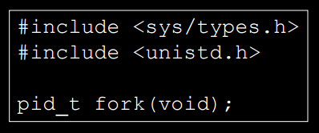
Syntax
Returns: 0 in child, process ID of child in parent, -1 on error.
fork() is called once, but it returns twice
The return value in the child is 0. The return value in the parent is the PID of the new Child.

Slide 15
The order of execution of the parent and the child may vary depending upon the process scheduling algorithm.
The reason the child's PID is returned to the parent is that a process can have more than one child.
No function are to obtain the PIDs of its children.

Slide 16
The reason fork returns 0 to the child is that a process can have only a single parent.
The child can always call getppid to obtain the PID of its parent.
using fork() function, we can create a exact same copy of the calling process,

Slide 17
Both the child and the parent continue executing with the instruction that follows the call to fork.
The child is a copy of the parent.
For example, the child gets a copy of the parent's data space, heap, and stack.
the parent and the child do not share these portions of memory.
The parent and the child share the text segment .
Fork duplicates a process: it creates a child process which is almost identical to the parent process

Slide 18
fork() takes no arguments and returns a process ID.
If fork() returns a negative value, the creation of a child process was unsuccessful.
fork() returns a zero to the newly created child process.
fork() returns a positive value, the process ID of the child process, to the parent.
The returned process ID is of type pid_t defined in sys/types.h.

Slide 19
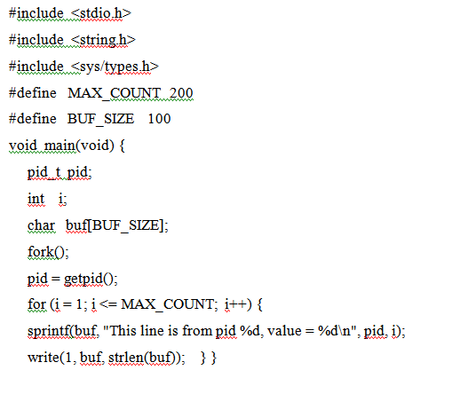

Slide 20
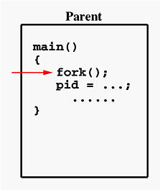
program executes up to the point of the call to fork() (marked in red color)

Slide 21
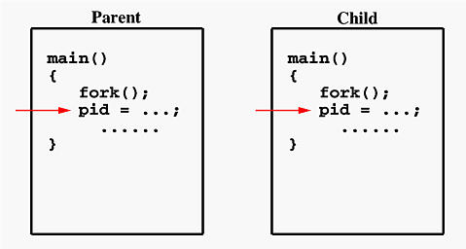
If the call to fork () is executed successfully
Make two identical copies of address spaces, one for the parent and the other for the child.
Both processes will start their execution at the next statement following the fork () call. In this case, both processes will start their execution at the assignment statement as shown below:

Slide 22
Both processes start their execution right after the system call fork().
Since both processes have identical but separate address spaces, those variables initialized before the fork() call have the same values in both address spaces.
Since every process has its own address space, any modifications will be independent of the others.

Slide 23
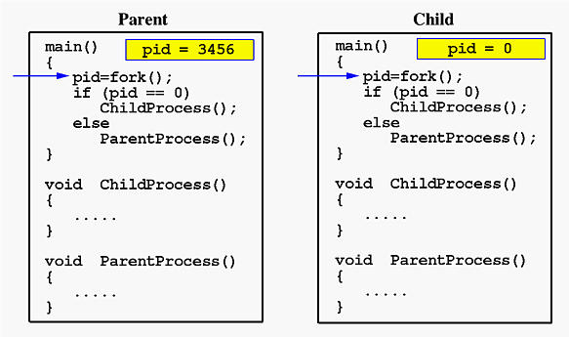

Slide 24
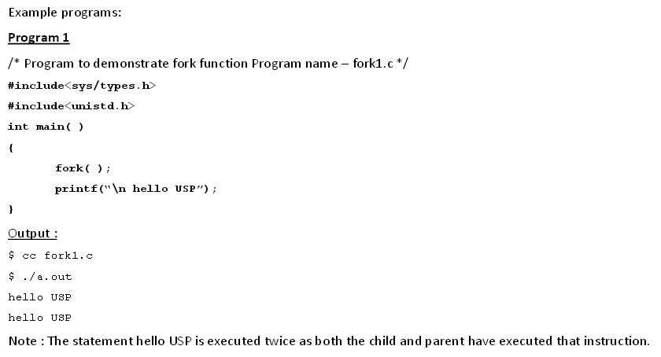

Slide 25
File Sharing

Slide 26
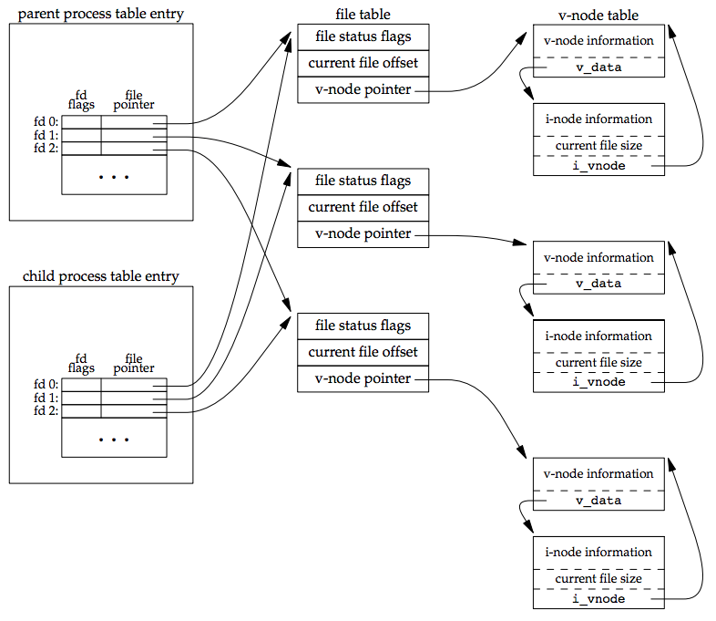
File Sharing

Slide 27
one characteristic of fork is that all file descriptors that are open in the parent are duplicated in the child.
The parent and the child share a file table entry for every open descriptor.
the parent and the child share the same file offset.
a process that forks a child, then waits for the child to complete. Assume that both processes write to standard output as part of their normal processing.

Slide 28
the child can write to standard output while the parent is waiting for it; on completion of the child, the parent can continue writing to standard output.
There are two normal cases for handling the descriptors after a fork:
The parent waits for the child to complete. In this case, the parent does not need to do anything with its descriptors.
When the child terminates, any of the shared descriptors that the child read from or wrote to will have their file offsets updated accordingly.

Slide 29
Besides the open files, there are numerous other properties of the parent that are inherited by the child:
Real user ID, real group ID, effective user ID, effective group ID
Supplementary group IDs
Process group ID
Session ID
Controlling terminal
The set-user-ID and set-group-ID flags
Current working directory
Root directory
File mode creation mask
Signal mask and dispositions
The close-on-exec flag for any open file descriptors
Environment
Attached shared memory segments
Memory mappings
Resource limits

Slide 30
differences between the parent and child
The return value from fork
The process IDs are different
The two processes have different parent process IDs: the parent process ID of the child is the parent; the parent process ID of the parent doesn't change
The child's tms_utime, tms_stime, tms_cutime, and tms_cstime values are set to 0
File locks set by the parent are not inherited by the child
Pending alarms are cleared for the child
The set of pending signals for the child is set to the empty set

Slide 31
two main reasons for fork to fail are
if too many processes are already in the system, which usually means that something else is wrong, or
if the total number of processes for this real user ID exceeds the system's limit.

Slide 32
two uses for fork
When a process wants to duplicate itself so that the parent and child can each execute different sections of code at the same time.
This is common for network servers
the parent waits for a service request from a client.
When the request arrives, the parent calls fork and lets the child handle the request.
The parent goes back to waiting for the next service request to arrive.

Slide 33
When a process wants to execute a different program. This is common for shells. In this case, the child does an exec right after it returns from the fork.

Slide 34
vfork ( )FUNCTION
The fork() function generates two identical processes with separate memory.
But The vfork() function generates two processes that share the same memory.
vfork() the parent will wait for the child terminates.
The parent inherits from the variables that the program is sharing.
after the child was called, all variables modified inside the child will still be modified inside the parent.

Slide 35
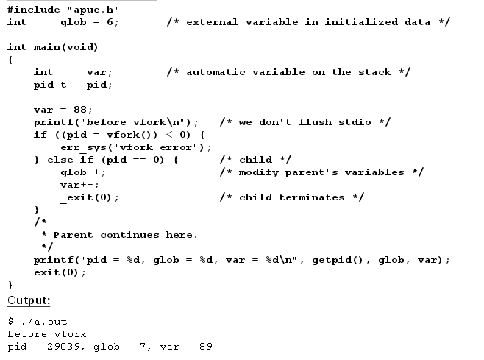

Slide 36
exit Functions
Executing a return from the main function.
Calling the exit function.
Calling the _exit or _Exit function.
Executing a return from the start routine of the last thread in the process.
Calling the pthread_exit function from the last thread in the process

Slide 37
three forms of abnormal termination
Calling abort. This is a special case of the next item, as it generates the SIGABRT signal.
When the process receives certain signals -The signal can be generated by the process itself for example, by calling the abort function by some other process, or by the kernel.

Slide 38
The last thread responds to a cancellation request. By default, cancellation occurs in a deferred manner: one thread requests that another be canceled, and sometime later, the target thread terminates.

Slide 39
_exit( ) and _Exit ( ) function:-
_exit and _Exit:- which return to the kernel immediately.
Exit ( ) function:-
exit, which performs certain cleanup processing and then returns to the kernel.
What is a zombie process?
In Linux OS, a zombie process is a finished (dead) process, but it has still occupied an entry in the process table.

Slide 40
wait() and waitpid() Functions
There are some certain situations:
when a child process terminates or changes state.
Then the parent process should come to know about the change of the state or termination status of the child process.
In that case functions like wait() are used by the parent process where the parent can query the change in state of the child process using these functions.

Slide 41
The system call wait() is easy.
The wait() function blocks the calling process until one of its child processes exits or a signal is received.
For our purpose, we shall ignore signals. wait() takes the address of an integer variable and returns the PID of the completed process.
Some flags that indicate the completion status of the child process are passed back with the integer pointer.
One of the main purposes of wait() is to wait for completion of child processes.

Slide 42
A process that calls wait or waitpid:
Block( if all of its children are still running).
Return immediately with the termination status of a child.(if child has terminated and is waiting for its termination status to be fetched)
Return immediately with an error( if doesn’t have any child processes)

Slide 43
The syntax of wait() is :
#include<sys/types.h>
#include<sys/wait.h>
pid_t wait(int *status);
pid_t waitpid(pid_t pid, int *status, intoptions);

Slide 44
Difference between wait and waitpid
The wait function can block the caller until a child process terminates.
waitpid has an option that prevents it from blocking.
The waitpid function doesn't wait for the child that terminates first; it has a number of options that control which process it waits for.

Slide 45
If a child has already terminated and is a zombie, wait returns immediately with that child's status. Otherwise, it blocks the caller until a child terminates.
If the caller blocks and has multiple children, wait returns when one terminates.
Function always tell which child terminated, because the process ID is returned by the function.

Slide 46
For both functions, the argument status is a pointer to an integer.
If this argument is not a null pointer, the termination status of the terminated process is stored in the location pointed to by the argument.
If we don't care about the termination status, we simply pass a null pointer as this argument.

Slide 47
The integer status is returned by these two function has defined by the implementation with certain bits indicating the exit status ( for normal termination).
The integer status is returned by these two function has defined by the implementation with certain bits indicating the signal number ( for abnormal termination).

Slide 48
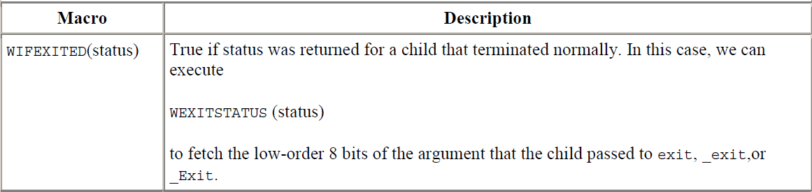
POSIX.1 specifies that the termination status is to be looked at using various macros that are defined in <sys/wait.h>.
There are three mutually exclusive macros tell us how the process terminated, and they all begin with WIF.

Slide 49
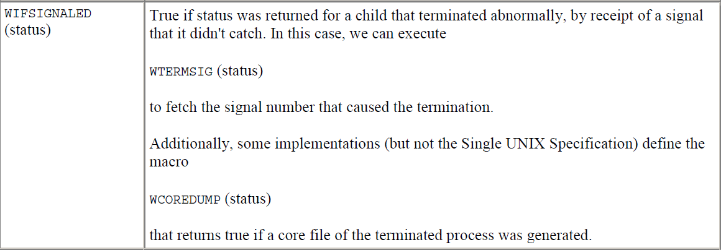

Slide 50
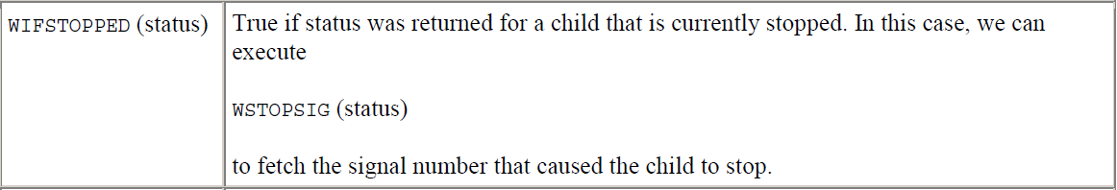

Slide 51
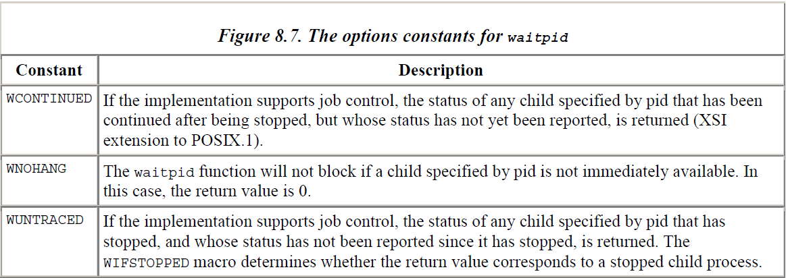

Slide 52
The understanding of the pid argument for waitpid depends on its value
pid == –1 Waits for any child process. In this respect, waitpid is equivalent to wait.
pid > 0 Waits for the child whose process ID equals pid.
pid == 0 Waits for any child whose process group ID equals that of the calling process.
pid < –1 Waits for any child whose process group ID equals the absolute value of pid.

Slide 53
The waitpid function provides three features that aren't provided by the wait function
The waitpid function lets us wait for one particular process, whereas the wait function returns the status of any terminated child. We'll return to this feature when we discuss the popen function.
The waitpid function provides a nonblocking version of wait. There are times when we want to fetch a child's status, but we don't want to block.
The waitpid function provides support for job control with the WUNTRACED and WCONTINUED options.

Slide 54
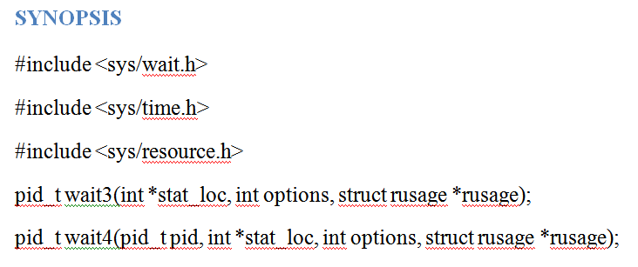
Wait3 and wait4 functions
Additional two functions.
wait for child process to change state.
wait for process termination

Slide 55
The wait3 function suspends execution of the current process pending a child has exited, or until a signal is delivered whose action is to terminate the current process.
If a child has already exited by the time of the call the function returns immediately.

Slide 56
The wait4 function suspends execution of the current process until a child as specified by the pid argument has exited, or until a signal is delivered whose action is to terminate the current process or to call a signal handling function.
If a child as requested by pid has already exited by the time of the call, the function returns immediately.

Slide 57
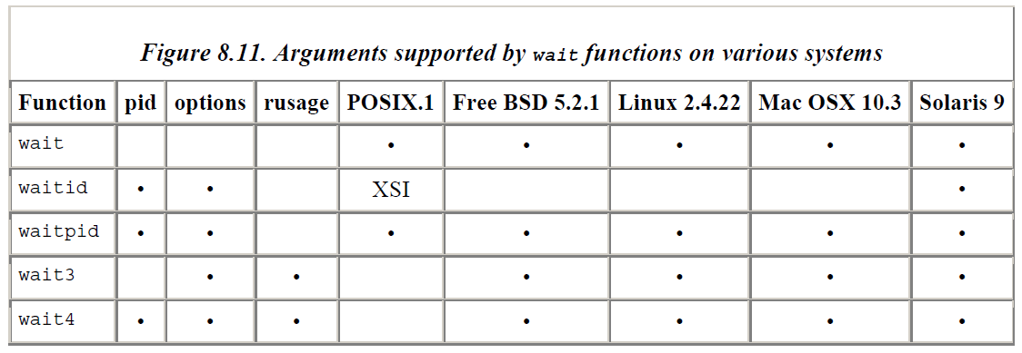

Slide 58
Race Conditions
A race condition is an undesirable situation that occurs when a device or system attempts to perform two or more operations at the same time.
but because of the nature of the device or system, the operations must be done in the proper sequence to be done correctly.

Slide 59
Exec functions
exec is a functionality of an operating system that runs an executable file (process ) in the context of an already existing process, replacing the previous executable.
When a process calls one of the exec functions, that process is completely replaced by the new program, and the new program starts executing at its main function.

Slide 60
The process ID does not change across an exec, because a new process is not created; exec only replaces the current process.
But the machine code, data, heap, and stack of the process are replaced by those of the new program.
Fork creates new processes, and exec functions initiate new programs.
The exit and wait functions handle termination and waiting for termination.

Slide 61
There are six exec functions, these six exec functions round out the UNIX control primitives.
#include<unistd.h>
int execl(const char *pathname, const char *arg0,………./*(char *) 0 */ );
int execv(const char *pathname, const char *argv[] );
int execle(const char *pathname, const char *arg0,………./*(char *) 0, char *const envp[ ] */ );
int execve(const char *pathname, const char *argv[],char *const envp[ ]);
int execlp(const char *filename, const char *arg0,………./*(char *) 0 */ );
int execvp(const char * filename, const char *argv[] );
All six return: -1 on error, no return on success.

Slide 62
The base of each is exec (execute), followed by one or more letters
e – An array of pointers to environment variables is explicitly passed to the new process image.
l – Command-line arguments are passed individually (a list) to the function.
p – Uses the PATH environment variable to find the file named in the file argument to be executed.
v – Command-line arguments are passed to the function as an array (vector) of pointers.

Slide 63
Parameters
path
The argument specifies the path name of the file to execute as the new process image. Arguments beginning at arg0 are pointers to arguments to be passed to the new process image. The argv value is an array of pointers to arguments.
arg0
The first argument arg0 should be the name of the executable file. Usually it is the same value as the path argument. Some programs may incorrectly rely on this argument providing the location of the executable, but there is no guarantee of this nor is it standardized across platforms.

Slide 64
envp
Argument envp is an array of pointers to environment settings.
The exec calls named ending with an e alter the environment for the new process image by passing a list of environment settings through the envp argument.
Each null-terminated string has the form:
name=value
where name is the environment variable name, and value is the value of that that variable. The final element of the envp array must be null.

Slide 65
difference between exec functions
execl, execv, execle and execve take a pathname argument, whereas execlp and execvp take a filename argument.
When a filename argument is specified:
If filename contains a slash, it is taken as a pathname.
Otherwise, the executable file is searched for in the directories specified by the PATH environment variable.

Slide 66
The path variable contains a list of directories that are separated by colons (:),
Example: PATH = /bin:/usr/bin:/usr/local/bin:.
The two functions execlp and execvp finds an executable file using one of the path prefixes, but the file isn’t a machine executable that was generated by the link editor, for example, the file is a shell script and tries to invoke /bin/sh with the file name as input to the shell.

Slide 67
2. the passing of the argument list ( l stands for list and v stands for vector).
The functions execl, execlp, and execle require each of the command-line arguments to the new program to be specified as separate arguments.
For the other three functions (execv, execvp, and execve), we have to build an array of pointers to the arguments, and the address of this array is the argument to these three functions.

Slide 68
3. the passing of the environment list to the new program.
The two functions whose names end in an e (execle and execve) allow us to pass a pointer to an array of pointers to the environment strings.
The other four functions, however, use the environ variable in the calling process to copy the existing environment for the new program.

Slide 69
The arguments of these six function hard to remember, but letter in the function names help somewhat.
The letter p means the functions takes filename argument and uses the PATH environment variable to find the executable file.
The letter l means the function takes a list of arguments and is mutually exclusive with the letter v, which means it takes an argv [ ] vector.
The letter e means the function takes an envp [ ] array, instead of using the current environment.

Slide 70
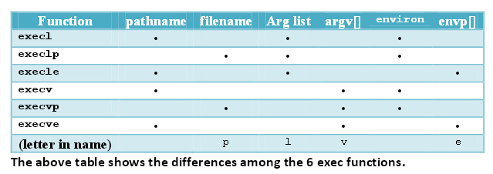

Slide 71
the process ID does not change after an exec, but the new program inherits additional properties from the calling process
Process ID and parent process ID
Real user ID and real group ID
Supplementary group IDs
Process group ID
Session ID
Controlling terminal
Time left until alarm clock
Current working directory
Root directory
File mode creation mask
File locks
Process signal mask
Pending signals
Resource limits
Values for tms_utime, tms_stime, tms_cutime, and tms_cstime.

Slide 72
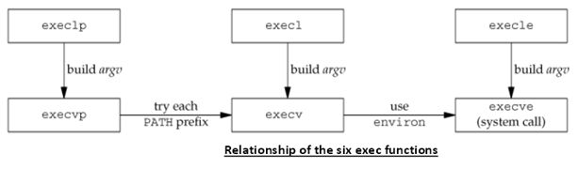

Slide 73
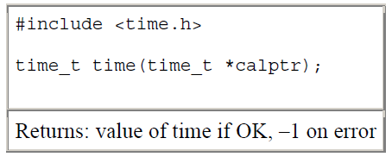
System() function
Time () function:-
The time() function returns the current time and date.

Slide 74
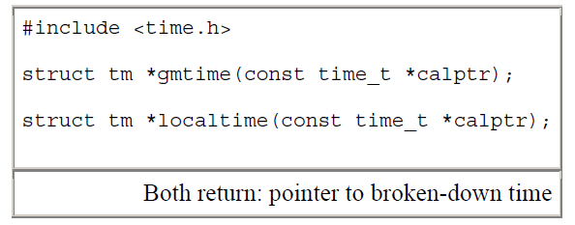
Localtime() function
localtime and gmtime:- The first converts the calendar time to the local time, taking into account the local time zone and daylight saving time flag, whereas the latter converts the calendar time into a broken-down time expressed as UTC.

Slide 75
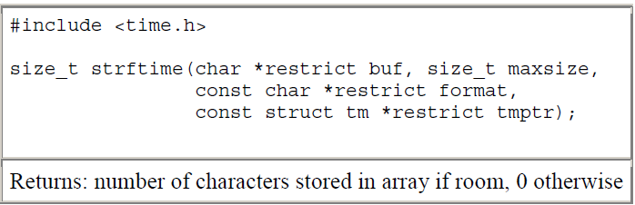
Strftime() function
The final time function, strftime. It is a printf-like function for time values.

Slide 76
System() Function
System() function is to execute a command string from within a program.
Invokes the command processor to execute a command.
Example:- Assume we want to put a time-and-date stamp into a certain file.
First call time() to get the current calendar time, then call localtime() to convert it to a broken-down time, and then call strftime() to format the result, and write the results to the file.

Slide 77
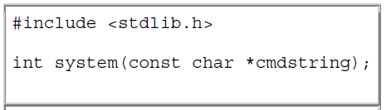
It is much easier, by using
system("date > file");
ISO C defines the system function, but its operation is strongly system dependent. POSIX.1 includes the system interface.

Slide 78
Parameters: cmdstring
C-string containing the system command to be executed. Or
alternatively, a null pointer, to check for a command processor.
If cmdstring is a null pointer, system returns nonzero only if a command processor is available.
This feature determines whether the system function is supported on a given operating system.
Under the UNIX System, system is always available.

Slide 79
system is implemented by calling fork, exec, and waitpid, there are three types of return values.
If either the fork fails or waitpid returns an error other than EINTR, system returns –1 with errno set to indicate the error.
if the exec fails, involve that the shell can't be executed, the return value is as if the shell had executed exit.
Otherwise, all three functions—fork, exec, and waitpid—succeed, and the return value from system is the termination status of the shell, in the format specified for waitpid.

Slide 80
/* system() example */
#include <stdio.h>
#include <stdlib.h>
int main ()
{
int i;
printf ("Checking if processor is available...");
if (system(NULL)) puts ("Ok");
Else
exit (EXIT_FAILURE);
printf ("Executing command DIR...\n");
i=system ("dir");
printf ("The value returned was: %d.\n",i);
return 0;
}

Slide 81
Effective user ID:- The effective UID (euid) of a process is used for most access checks.
Saved user ID:-The saved user ID (suid) is used when a program running with important rights needs to temporarily do some unprivileged work: it changes its effective user ID from a privileged value (typically root) to some unprivileged one, and this triggers a copy of the privileged user ID to the saved user ID slot.

Slide 82
Real user ID:-The real UID (ruid) and real GID (rgid) identify the real owner of the process and affect the permissions for sending signals.
A process without superuser privilege can signal another process only if the sender's real or effective UID matches the real or saved UID of the receiver.

Slide 83
User identification
Any process can find out its real and effective user ID and group ID.
Sometimes, we want to find out the login name of the user who's running the program.
call getpwuid(getuid()), but what if a single user has multiple login names, each with the same user ID. ( person might have multiple entries in the password file with the same user ID to have a different login shell for each entry.)
The system normally keeps track of the name we log in and the getlogin function provides a way to fetch that login name.

Slide 84
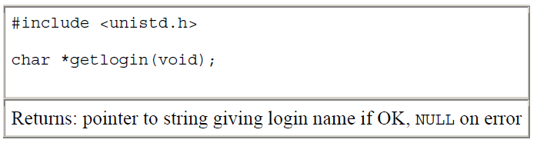
This function can fail if the process is not attached to a terminal that a user logged in to.
To find the login name, UNIX systems have historically called the ttyname function and then tried to find a matching entry in the utmp file.
FreeBSD and Mac OS X store the login name in the session structure associated with the process table entry and provide system calls to fetch and store this name.

Slide 85
System V provided the cuserid function to return the login name.
This function called getlogin and, if that failed, did a getpwuid(getuid()).

Slide 86
Process Times
UNIX systems have maintained two different time values:
Calendar time
Process time
Calendar time: This value counts the number of seconds since the Epoch: 00:00:00 January 1, 1970, Coordinated Universal Time (UTC).
These time values are used to record the time when a file was last modified.

Slide 87
Process time: This is also called CPU time and measures the central processor resources used by a process.
Process time is measured in clock ticks, which have historically been 50, 60, or 100 ticks per second.
When we measure the execution time of a process, the UNIX System maintains three values for a process:
Clock time
User CPU time
System CPU time

Slide 88
clock time:-
sometimes called wall clock time.
Clock time is the amount of time the process takes to run, and its value depends on the number of other processes being run on the system.
Whenever we report the clock time, the measurements are made with no other activities on the system.

Slide 89
user CPU time and system CPU time:-
User CPU time is the CPU time attributed (qualified) to user instructions.
The system CPU time is the CPU time attributed to the kernel when it executes on behalf of the process.
Example:-
whenever a process executes a system service, such as read or write, the time spent within the kernel performing that system service is charged to the process.
The sum of user CPU time and system CPU time is often called the CPU time.

Slide 90
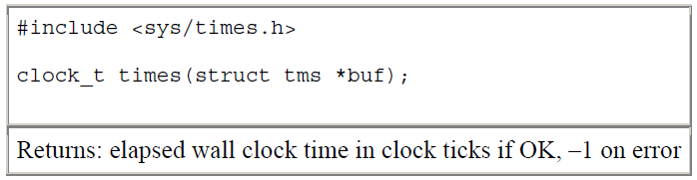
Any process can call the times function to obtain wall clock time, user CPU time, and system CPU time values for itself and any terminated children.

Slide 91
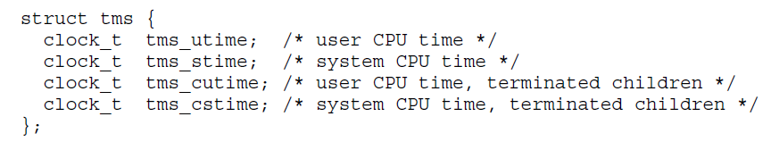
times function fill in the tms structure pointed to by buf

Slide 92
The structure does not contain any measurement for the wall clock time.
as an alternative, the function returns the wall clock time as the value of the function, each time it's called.
This value is measured from some arbitrary point in the past, so we can't use its absolute value; instead, we use its relative value.

Slide 93
Changing User IDs and group IDs
When our programs need additional privileges or resources.
They currently aren't allowed to access, they need to change their user or group ID to an ID that has the appropriate privilege or access.
Similarly, when our programs need to lower their privileges or prevent(stop) access to certain resources, they do so by changing either their user ID or group ID to an ID without the privilege or ability access to the resource.

Slide 94
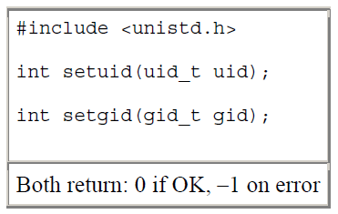
set the real user ID and effective user ID using setuid function.
set the real group ID and the effective group ID using setgid function.

Slide 95
There are some rules for who can change the IDs.
If the process has super user privileges, the setuid function sets the real user ID, effective user ID, and saved set-user-ID to uid.
If the process does not have super user privileges, but uid equals either the real user ID or the saved set-user-ID, setuid sets only the effective user ID to uid. The real user ID and the saved set-user-ID are not changed.
If neither of these two conditions is true, errno is set to EPERM, and 1 is returned.

Slide 96
A few statements about the three user IDs that the kernel maintains
Only a superuser process can change the real user ID.
Normally, the real user ID is set by the login(1) program when we log in and never changes.
Because login is a superuser process, it sets all three user IDs when it calls setuid.

Slide 97
2. The effective user ID is set by the exec functions only if the set-user-ID bit is set for the program file.
If the set-user-ID bit is not set, the exec functions leave the effective user ID as its current value.
We can call setuid at any time to set the effective user ID to either the real user ID or the saved set-user-ID.

Slide 98
3. The saved set-user-ID is copied from the effective user ID by exec.
If the file's set-user-ID bit is set, this copy is saved after exec stores the effective user ID from the file's user ID.

Slide 99
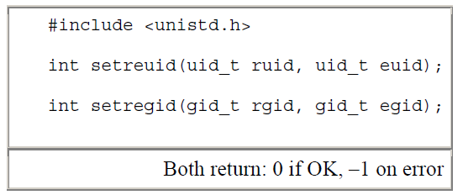
setreuid and setregid Functions
The exchange of the real user ID and the effective user ID with the setreuid function.
The swapping of the real group ID and the effective group ID with the setregid function.

Slide 100
supply a value of 1 for any of the arguments to indicate that the corresponding ID should remain unchanged.
This allows a set-user-ID program to swap to the user’s normal permissions and swap back again later for set-user- ID operations.

Slide 101
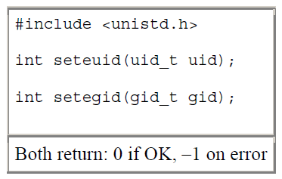
seteuid and setegid functions
POSIX.1 includes the two functions seteuid and setegid.
functions are similar to setuid and setgid,
only the effective user ID or effective group ID is changed is the difference.

Slide 102
An unprivileged user can set its effective user ID to either its real user ID or its saved set-user-ID.
For a privileged user, only the effective user ID is set to uid.
(This differs from the setuid function, which changes all three user IDs.)

Slide 103
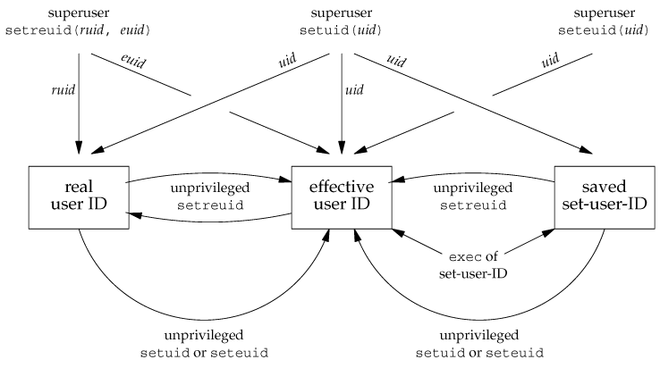

Slide 104
Group IDs
Everything in the changing user IDs steps is also applies in a similar fashion to group IDs.
The supplementary group IDs are not affected by setgid, setregid, or setegid.

Slide 105
Process Accounting
Most UNIX systems provide an option to do process accounting.
Process accounting is enabled, the kernel writes an accounting record each time a process terminates.
accounting records are small amount of data with the name of the command - the amount of CPU time used, the user ID and group ID, the starting time, and so on.

Slide 106
A super-user executes accton with a pathname argument to enable accounting.
The accounting records are written to the specified file - /var/account/acct.
Accounting is turned off by executing accton without any arguments.
Each accounting record is written when the process terminates.

Slide 107
The order of the records in the accounting file corresponds to the termination order of the processes, not the order in which they were started.
The accounting records correspond to processes, not programs.

Slide 108
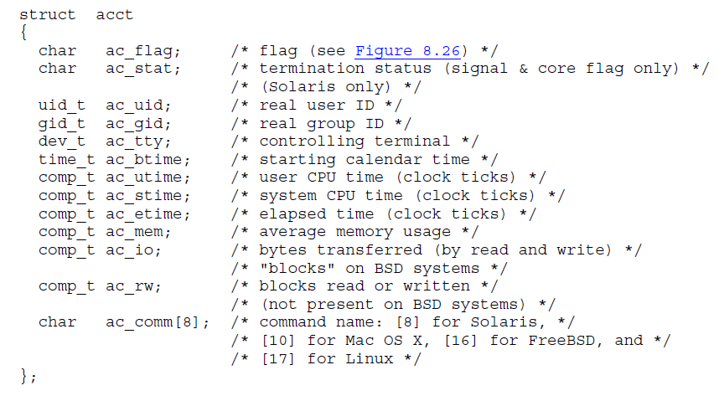
The structure of the accounting records is defined in the header <sys/acct.h>.

Slide 109
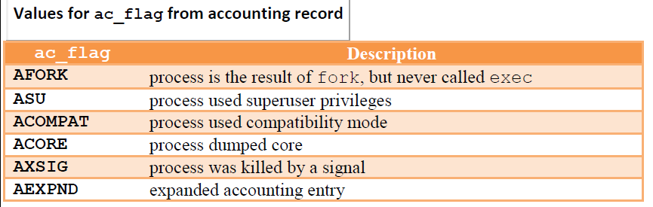

Slide 110
INTERPRETER FILES
Predictor
Analyst
Judge
forward planner

Slide 111
Interpreter files are text files that are read in (interpreted) by the program specified on the first line.
Syntax of interpreter file is:
#! pathname [ optional-argument ]
The space between the exclamation point and the pathname is optional.
The most common of these interpreter files begin with the line:
#!/bin/sh

Slide 112
Why and how are they used has:
can say "it depends". When should you write a script. write a program - it depends.
Which scripting language should you use - it depends numerous interpreters - perl, python, bash, ksh, awk.
The interpreter file is the program that runs the rest of the script.
The main use of specifying an interpreter file is to make it easier to run the program and to make sure the correct interpreter is used

Slide 113
#! pathname [ optional-argument ]:
The pathname is normally an absolute pathname, since no special operations are performed on it.
The recognition of these files is done within the kernel as part of processing the exec system call.
The actual file that gets executed by the kernel is not the interpreter file, but the file specified by the pathname on the first line of the interpreter file.

Slide 114


